Slide 1

Classifying MNIST digits using MLP
TA. Jaewoong Han
Machine Learning &
Control Systems Lab.

Slide 2
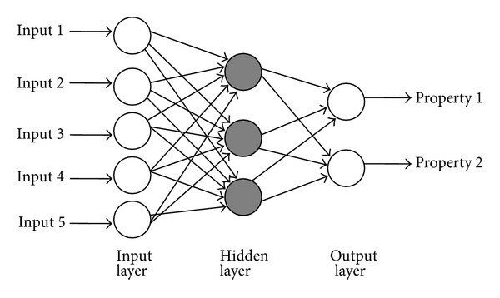
Multi Layer Perceptron (MLP)
A multilayer perceptron (MLP) is a name for a modern feedforward artificial neural network, consisting of fully connected neurons with a nonlinear activation function, organized in at least three layers, notable for being able to distinguish data that is not linearly separable.

Slide 3
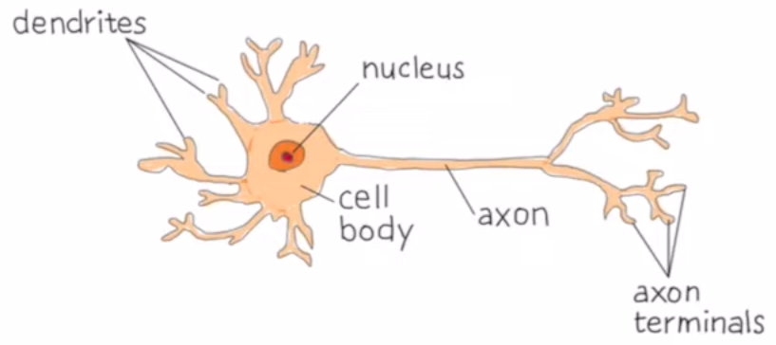
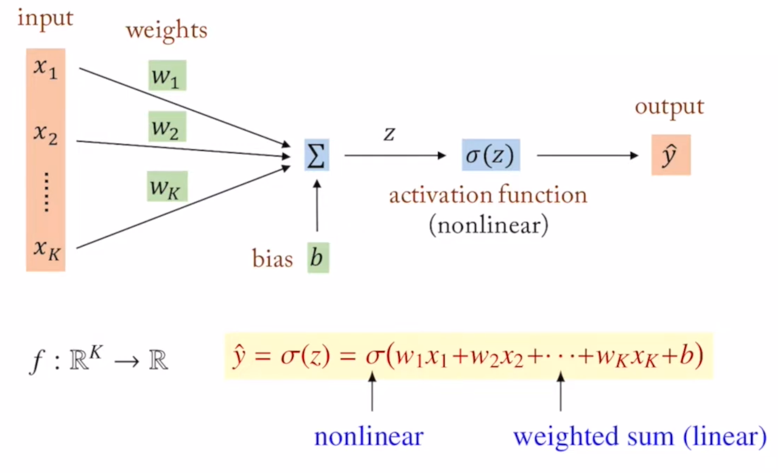
Feedforward

Slide 4
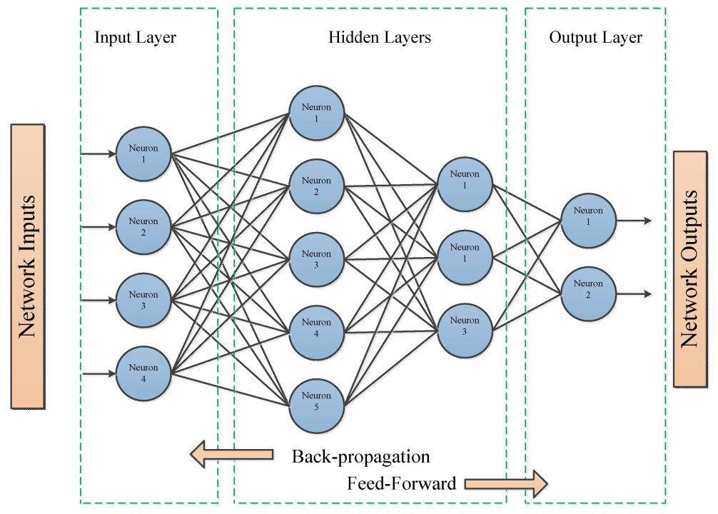
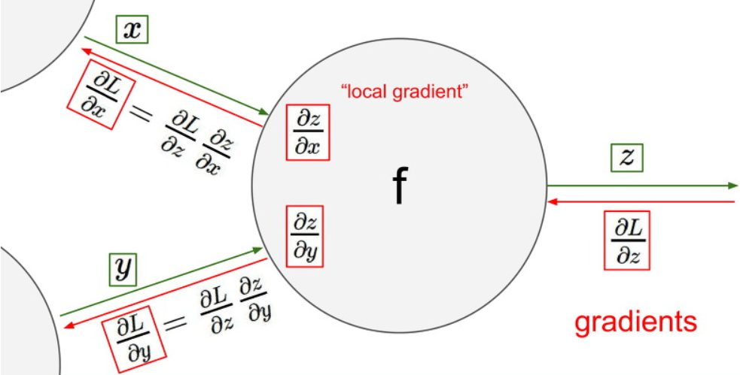
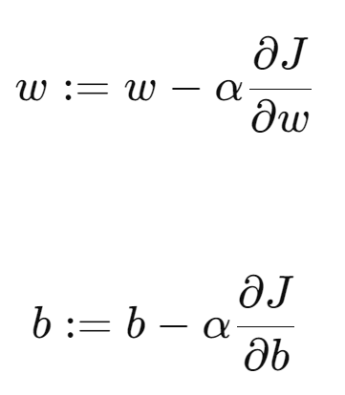
Backpropagation
Backpropagation is a gradient estimation method used to train neural network models. The gradient estimate is used by the optimization algorithm to compute the network parameter updates.
$$L$$
$$L$$
Notes:
https://velog.io/@fbdp1202/CS231n-%EC%A0%95%EB%A6%AC-4.-Back-propagation-and-Neural-Networks

Slide 5
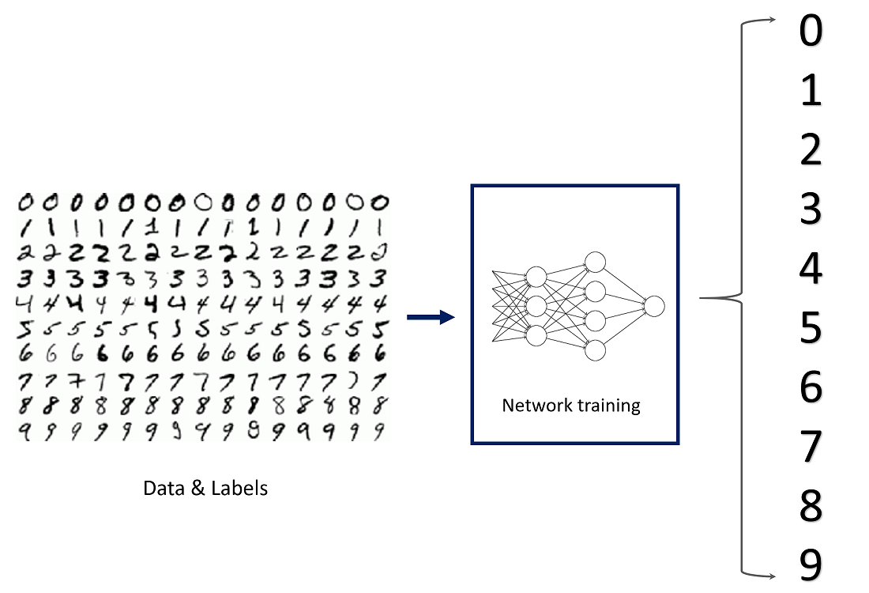
MNIST
Modified National Institute of Standards and Technology database
60,000 images for the training and 10,000 images for the test.
Size : 28x28 pixels
Only 1 channel (Gray scale)

Slide 6
Preparing Data
1. Load
- Use easy loading function in torchvision.datasets library
- Need to create custom loading function when trying to load your own dataset.
2. Reshape
- Change size/shape of the dataset array
3. Normalize
- Standardize features by removing the mean and scaling to unit variance
- Divide by the maximum value
4. Convert to one-hot encoding/vector
- Need when training a neural network which classifies given data

Slide 7
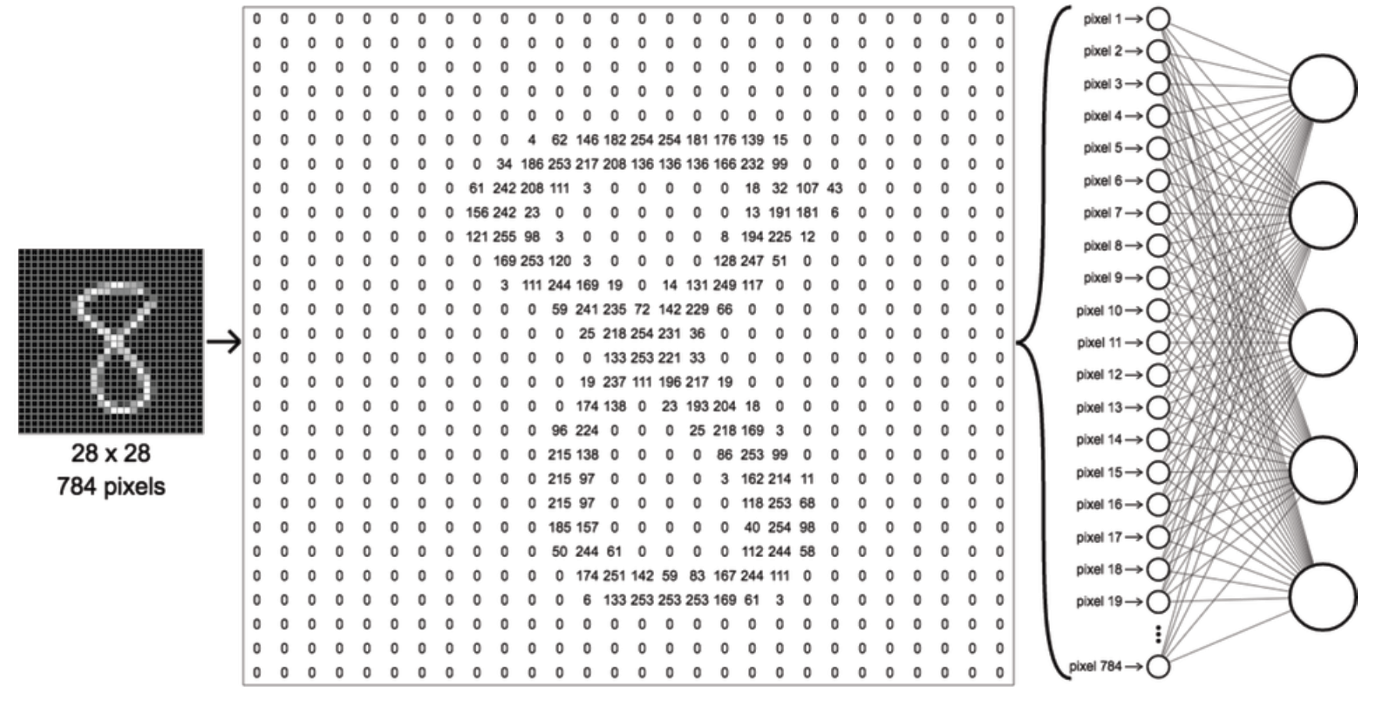

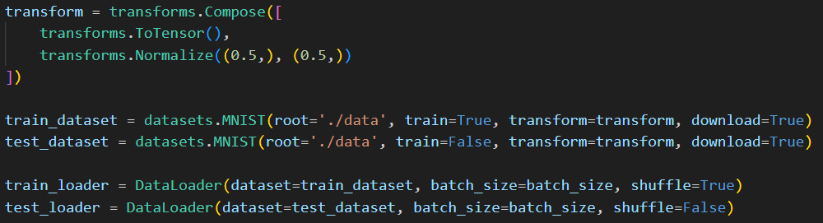
Preparing Data
To tensor & Scaling => (0, 1)
Normalize: output = (input – mean) / std => (-1, 1)

Slide 8
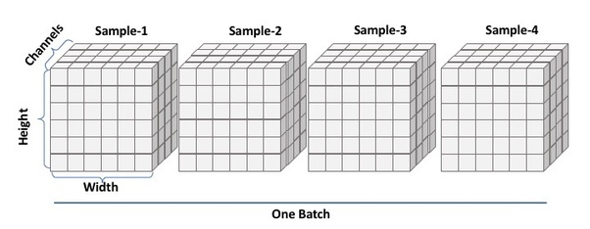
Batch, Mini-Batch, Epoch
Batch
- A batch is the entire dataset processed in one iteration of a machine learning algorithm.
Mini-batch
- A mini-batch is a small, randomly selected subset of the dataset processed in one iteration.
Epoch
- An epoch is one complete pass through the entire training dataset.
Batch size = 100
Mini batch (100)
Mini batch (100)
Mini batch (100)
Mini batch (100)
Mini batch (100)
Training Data(500)

Slide 9
Normalize
Required when features have different ranges
Common data preprocessing pipeline.
Left: Original toy, 2-dimensional input data.
Middle: The data is zero-centered by subtracting the mean in each dimension. The data cloud is now centered around the origin.
Right: Each dimension is additionally scaled by its standard deviation.
The red lines indicate the extent of the data - they are of unequal length in the middle, but of equal length on the right.

Slide 10
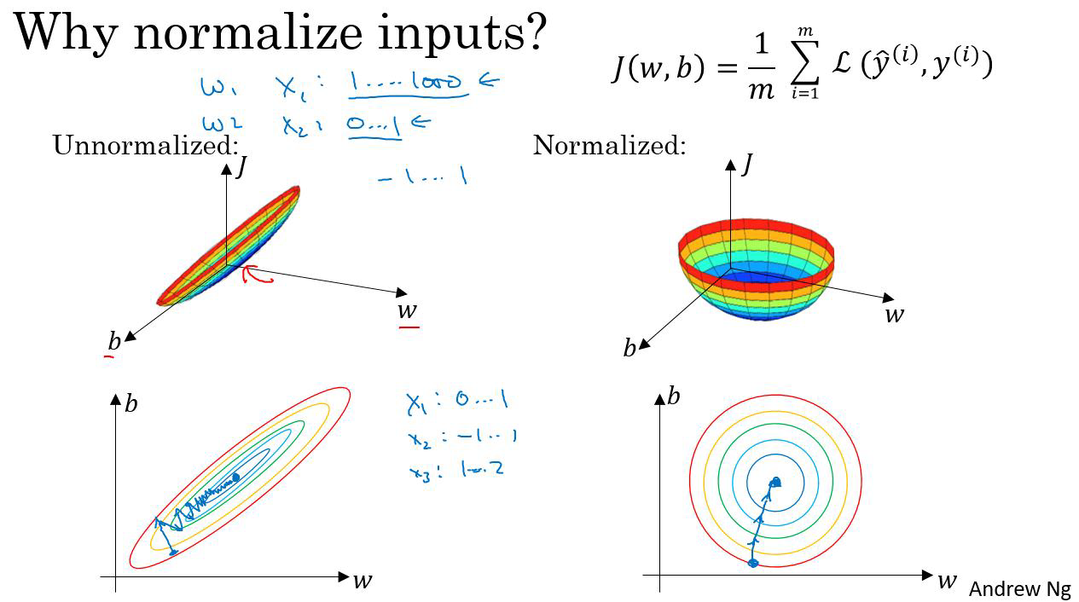
Normalize

Slide 11
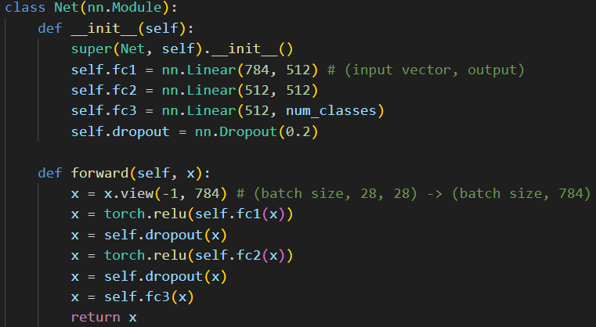
Creating a model
1. Define torch.nn.Module Class
- Easy way of creating a network.
2. Dense Layer
- Fully connected layer.
- Consists of weights and biases
3. Activation Functions
- Defines the output of the node
- ReLU, tanh, sigmoid
4. Dropout Layer
- Prevents overfitting
- Randomly removes the connections between weights
4. Softmax (not here)
- Converts the scores to the probabilities
- Usually locates at the end of the network

Slide 12
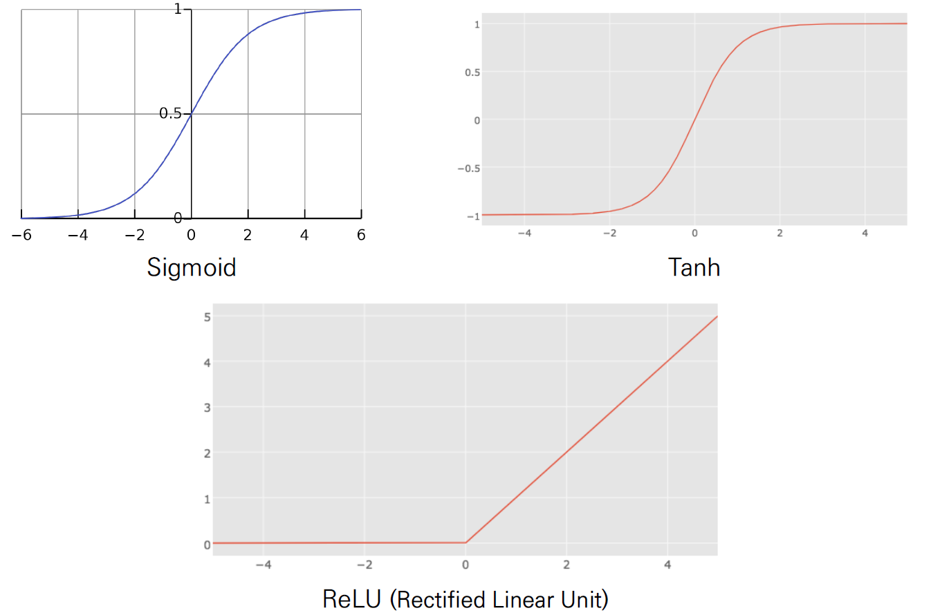

Activation Functions
Defines the output strength of the signal to the following layer
Select proper and better activation functions by trial and errors
$$f\left(x\right)=\frac{1}{1+e^{−x}} \\ f^{′}\left(x\right)=f\left(x\right)\left[1−f\left(x\right)\right]$$

Slide 13
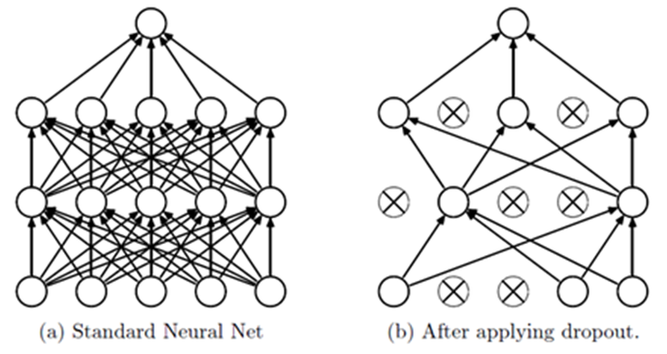
Dropout Layer
Prevents overfitting when the network has many hidden layers
Skips / removes the connections between weights

Slide 14
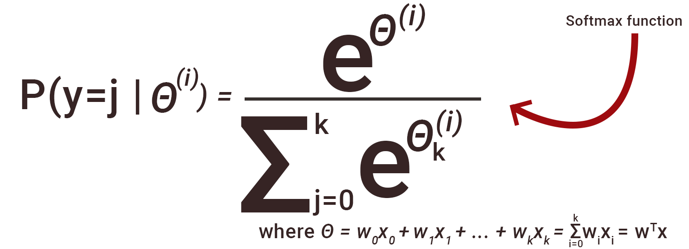
Softmax
Converts the scores to the probabilities
We select the index of the largest probability as a classification result

Slide 15
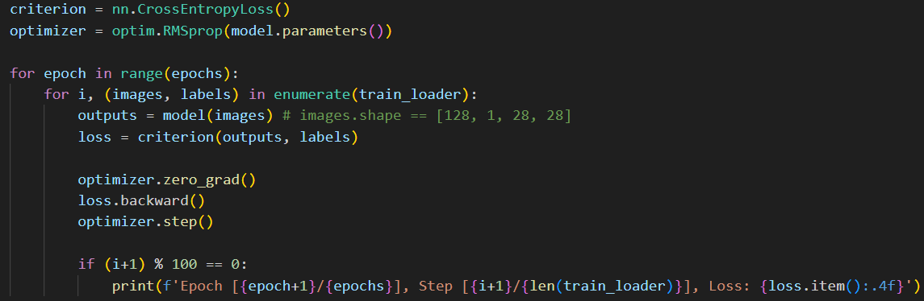
Training a network
1. Preparation
- Define loss function(criterion) / optimizer
- Set the right loss function for the current problem
(Use CrossEntropyLoss since the current problem is classification)
2. Training
- Actual training part.
- Need to put train data. Use validation data to monitor performance, if desired.
3. Evaluation
- Gives the loss and the accuracy of the classification results with given dataset

Slide 16
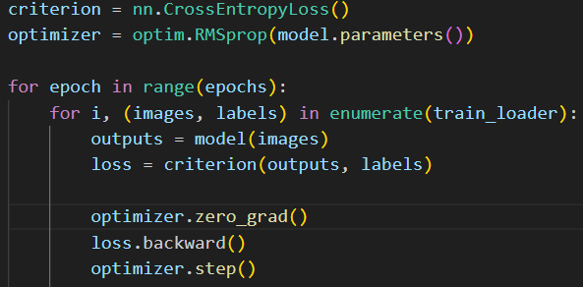

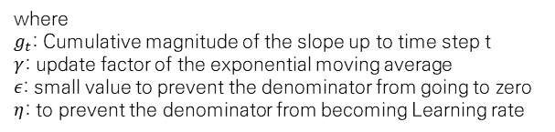
Preparation & Training
Loss function: nn.CrossEntropyLoss
$L_{CE}(p, t)=−\sum_{i=1}^{n}{t_{i}\log\left(p_{i}\right)}$ , for n classes
$where p_{i}=\frac{e^{p_{i}}}{\sum_{j}{e^{p_{j}}}}$
Optimizer: optim.RMSprop
Process of finding the parameters that minimize the value of the loss function.
Simple example: Gradient Descent Algorithm
RMSProp equation
$g_{t}=γg_{t−1}+\left(1−γ\right){\left(∇f\left(x_{t−1}\right)\right)}^{2}$
$x_{t}=x_{t−1}+\frac{η}{\sqrt{g_{t}+ε}} ⋅∇f\left(x_{t−1}\right)$
softmax
where $g_{t}$: Cumulative magnitude of the slope up to time step t $γ$: update factor of the exponential moving average
$ε$: small value to prevent the denominator from going to zero
$η$: to prevent the denominator from becoming Learning rate

Slide 17
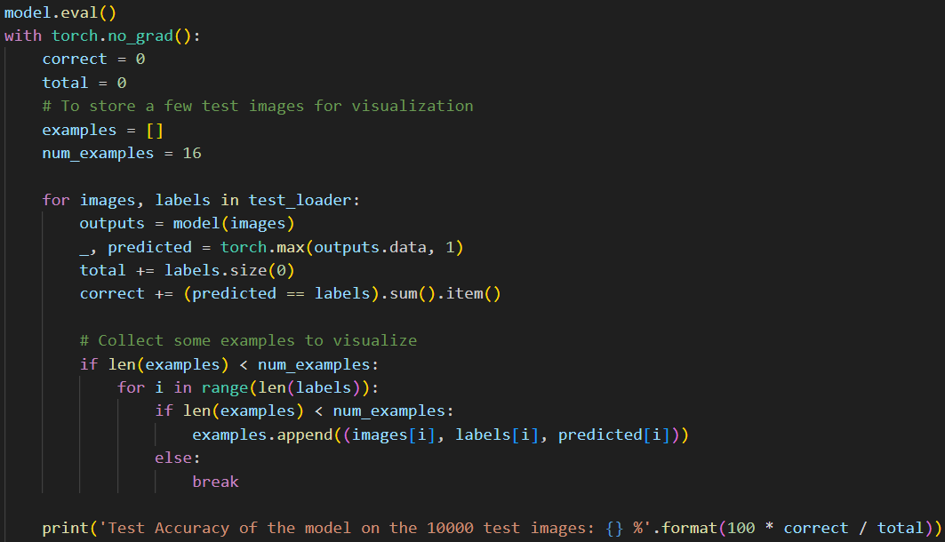
Evaluation

